Slide 1

" DIAPRO – Diabetes Prediction Application”
Exposys Data Labs Internship Project

Slide 2
Made By: Dhyey Joshi Supervisor : Mr. Vishnu Vardhan Sir Semester : 5th Branch : CSE

Slide 3
Introduction
1
Analysis Of Our Project Title

Slide 4
Abstract
Diabetes is a chronic disease with the potential to cause a worldwide health care crisis. According to the International Diabetes Federation 382 million people are living with diabetes across the whole world. By 2035, this will be doubled as 592 million. Diabetes mellitus or simply diabetes is a disease caused due to the increased level of blood glucose. Various traditional methods, based on physical and chemical tests, are available for diagnosing diabetes. However, early prediction of diabetes is quite a challenging task for medical practitioners due to complex interdependence on various factors as diabetes affects human organs such as kidney, eye, heart, nerves, foot etc. Data science methods have the potential to benefit other scientific fields by shedding new light on common questions. One such task is to help make predictions on medical data. Machine learning is an emerging scientific field in data science dealing with the ways in which machines learn from experience. The aim of this project is to develop a system which can perform early prediction of diabetes for a patient with a higher accuracy by combining the results of different machine learning techniques. This project aims to predict diabetes via 10 different supervised & Ensemble Machine Learning methods including: SVM, K Nearest Neighbor, Naive Bayes, Logistic Regression, Random Forest Classifier, AdaBoost, XgBoost, Gradient Boost, LightGBM, Extra Tree Classifier. This project also aims to propose an effective technique for earlier detection of the diabetes disease.

Slide 5
Proposed System
The whole project will be completed in 3 complex steps
a. Creating a model using machine learning
b. Creating a web app using flask and connecting it with model
c. Now, uploading project to GitHub, then connect Heroku with your GitHub account. Name your application – Click on Deploy Branch. Wahoo!! our application on fly now.

Slide 6
Classification is one of the most important decision making techniques in many real world problems.
In this work, the main objective is to classify the data as diabetic or non-diabetic and improve the classification accuracy. For many classification problems, the higher number of samples chosen doesn't leads to higher classification accuracy.
In many cases, the performance of algorithms is high in the context of speed but the accuracy of data classification is low. The main objective of our model is to achieve high accuracy.
Classification accuracy can be increased if we use much of the data set for training and few data sets for testing. This survey has analyzed various classification techniques for classification of diabetic and non-diabetic data. Thus, it is observed that techniques like Gradient Boosting & K nearest Neighbor are most suitable for implementing the Diabetes prediction system.

Slide 7
Existing problems | purposed System
Current System and its limitations
Still no effective solution
Time consuming clinical analysis
High cost
Experienced manpower
To develop a intelligent system to classify pd patients.
To contribute in medical sector
Reduce the cost of overall clinical analysis
Diagnose patient in early stages
Reduce mortality rate
To employ our proposed model which will give better performance then existing ones.

Slide 8
Hardware and Software Requirements
a) Python programming language.
b) Jupyter Notebook.
c) Google Colab.
D) Windows 7 / 10 Operating System.
E) RAM minimum 4Gb.

Slide 9
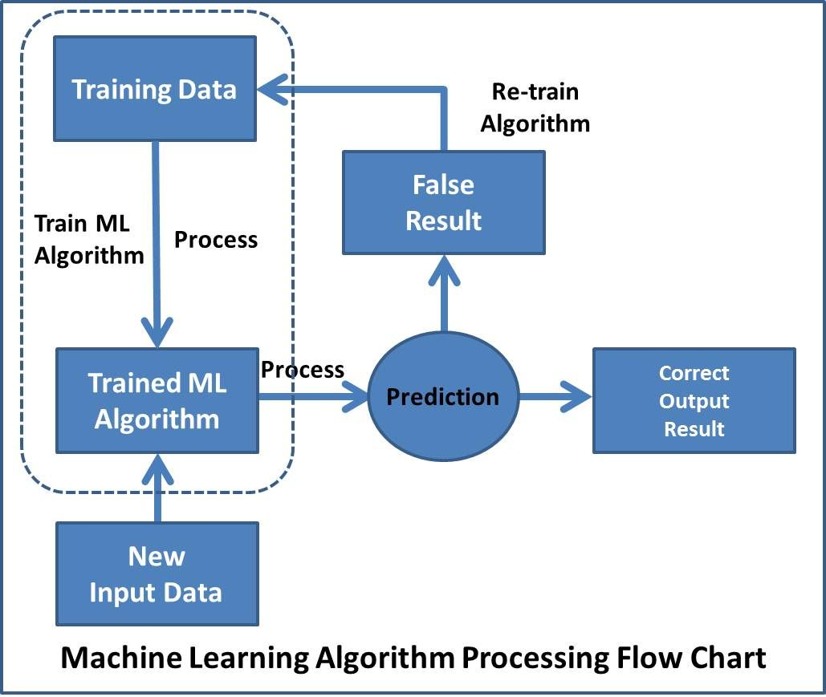
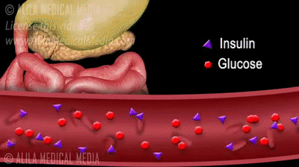
System Flow Chart

Slide 10

Overall Workflow
Classification
Naïve Bayes
Logistic Regression
K – nearest neighbors
Random Forest
SVM (Linear)
SVM (RBF)
SVM (Poly)
Data
Data Pre-Processing
Standardization
Feature Selection
Feature Extraction
Ensemble Voting
Result
Fig : Graphical representation of overall proposed Diabetes Classification System [4]

Slide 11
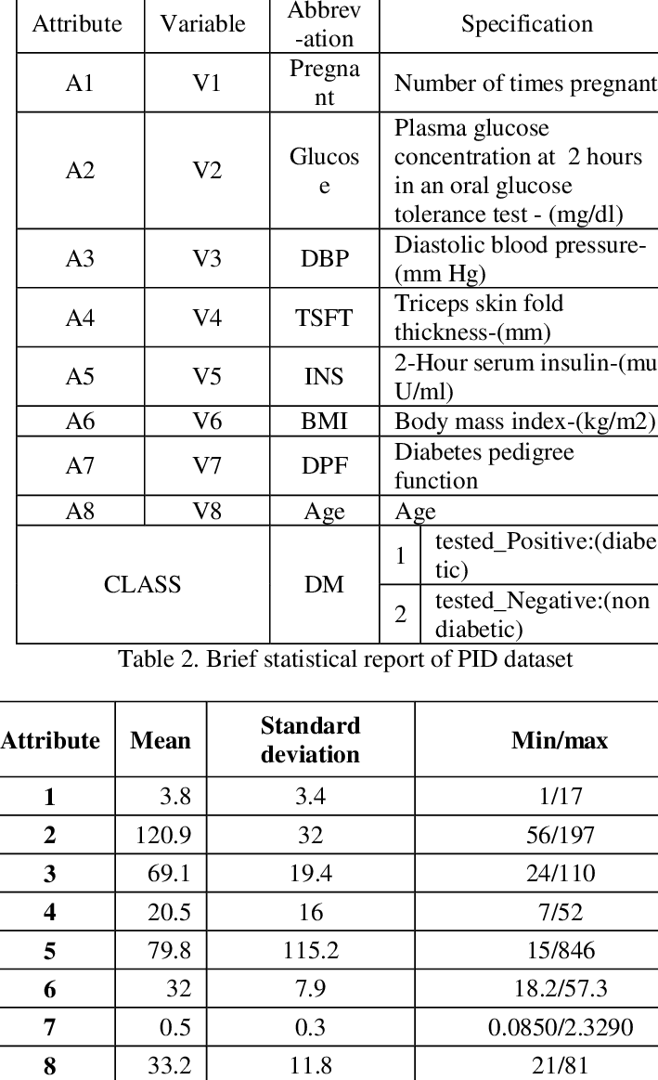
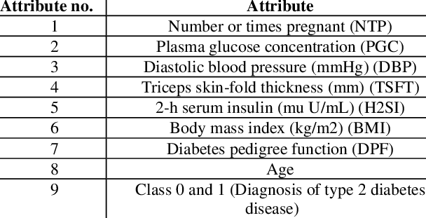
Dataset description
Fig : Dataset Description [ 5 ]

Slide 12
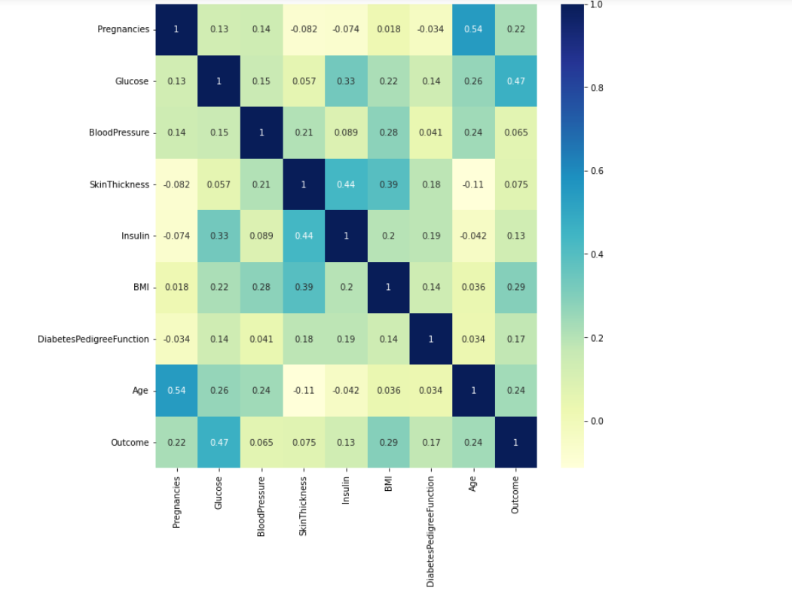
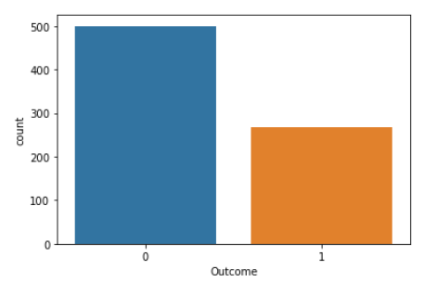
Dataset pre-processing
Fig : Correlation of features( High presence of correlation ) [ 6 ]
Fig : Non-Diabetic (0) – Diabetic (1) Ratio in dataset
[ 7 ]

Slide 13
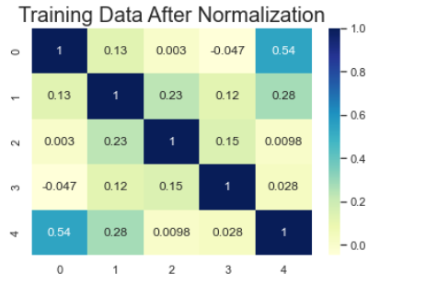
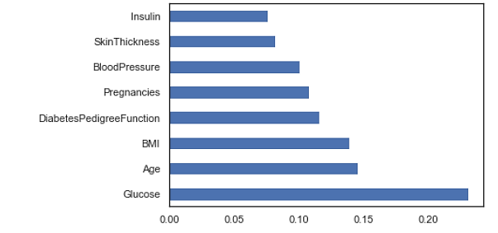
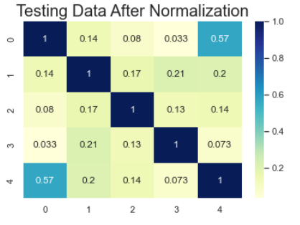
Feature Selection (Anova)
Fig : Feature Importance by ANOVA [ 8 ]
Fig : Correlation After Feature Extraction [ 9 ]

Slide 14
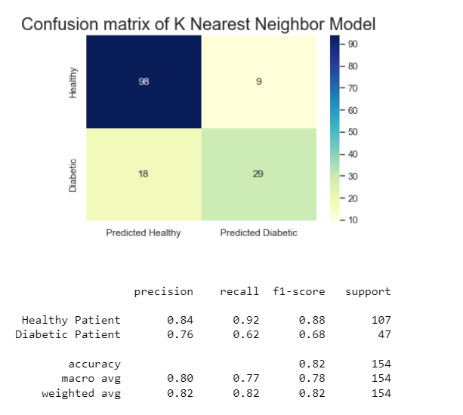
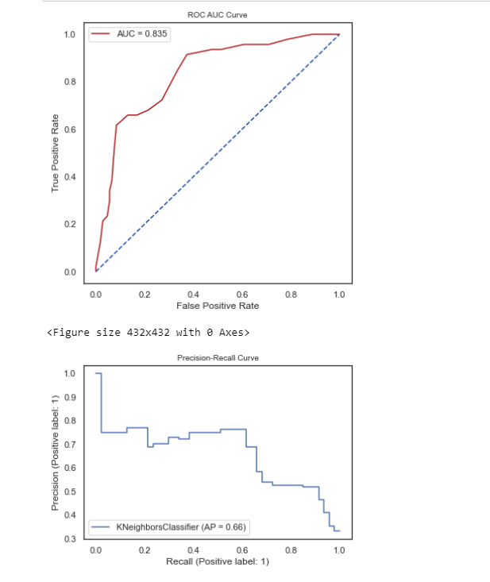
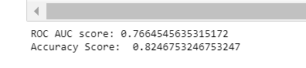
Best Result’s Of Two Model: KNN & GB
Fig : Roc & Auc Score [ 11 ]
Fig : Classification Results [10]

Slide 15
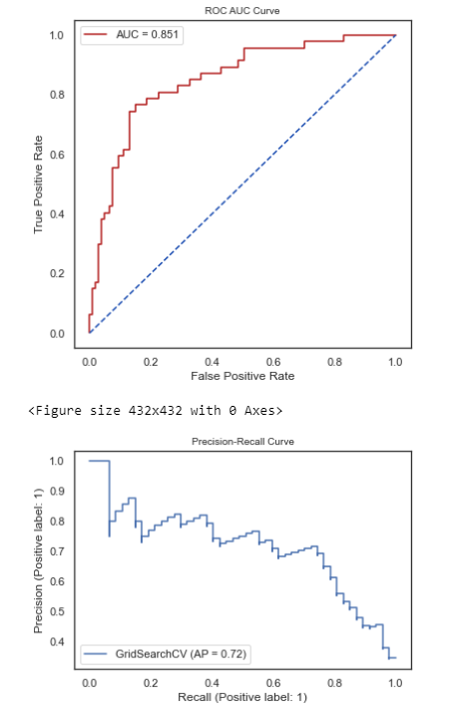
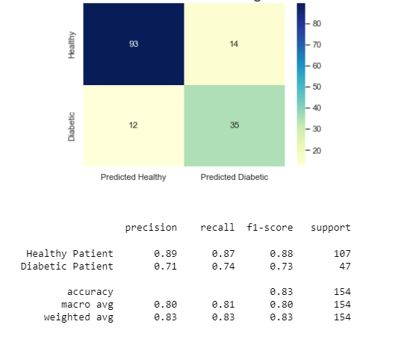
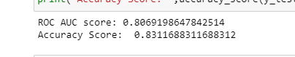
Gradient Boosting
Fig : Roc & Auc Score [ 11 ]
Fig : Classification Results [10]

Slide 16
conclusion
Machine learning has the great ability to revolutionize the diabetes risk prediction with the help of advanced computational methods and availability of large amount of epidemiological and genetic diabetes risk dataset. Detection of diabetes in its early stages is the key for treatment. This work has described a machine learning approach to predicting diabetes levels. The technique may also help researchers to develop an accurate and effective tool that will reach at the table of clinicians to help them make better decision about the disease status.

Slide 17
Previous works
[1] Debadri Dutta, Debpriyo Paul, Parthajeet Ghosh, "Analyzing Feature Importances for Diabetes Prediction using Machine Learning". IEEE, pp 942-928, 2018.
[2] K.VijiyaKumar, B.Lavanya, I.Nirmala, S.Sofia Caroline, "Random Forest Algorithm for the Prediction of Diabetes ".Proceeding of International Conference on Systems Compu- tation Automation and Networking, 2019.
[3] Md. Faisal Faruque, Asaduzzaman, Iqbal H. Sarker, "Perfor- mance Analysis of Machine Learning Techniques to Predict Diabetes Mellitus". International Conference on Electrical, Computer and Communication Engineering (ECCE), 7-9 Feb- ruary, 2019.
[4] Tejas N. Joshi, Prof. Pramila M. Chawan, "Diabetes Prediction Using Machine Learning Techniques".Int. Journal of Engineer- ing Research and Application, Vol. 8, Issue 1, (Part -II) Janu- ary 2018, pp.-09-13
[5] Nonso Nnamoko, Abir Hussain, David England, "Predicting Diabetes Onset: an Ensemble Supervised Learning Approach ". IEEE Congress on Evolutionary Computation (CEC), 2018.

Slide 18
Thanks!
Any questions?
You can find us at:
Email: dhyey1974@gmail.com
Linkedin:https://www.linkedin.com/in/dhyey-joshi12/
Made By: Dhyey Joshi

